Slide 1

Servlet Life Cycle Analysis Execution Flow, Lifecycle Methods & Performance Implications
DSA 0308 –Natural Language Processing
PRESENTED BY :
Srijtha S (192471024)

Slide 2


INTRODUCTION
What is a Servlet?
Definition
A Servlet is a Java-based server-side component used to process client requests and generate dynamic responses.
Objectives
Handle HTTP requests
Process client data
Generate dynamic responses
Connect web applications with backend services
Real-World Examples
Login systems
Online banking
E-commerce websites
Student portals
Hospital management systems

Slide 3
Contents
Introduction
Servlet Architecture
Servlet Life Cycle
init() Method
service() Method
destroy() Method
Sequence Diagram
Performance Analysis
Applications
Connecting Everything
Conclusion

Slide 4
SERVLET ARCHITECTURE
Servlet Container
The Servlet Container manages the complete lifecycle of a servlet.
Main Responsibilities
Load servlet
Create servlet object
Initialize servlet
Handle requests
Manage responses
Destroy servlet
Example
Client
↓
HTTP Request
↓
Web Server
↓
Servlet Container
↓
Servlet
↓
HTTP Response
↓
Client

Slide 5
SERVLET LIFE CYCLE
Definition
The Servlet Life Cycle describes the sequence of stages through which a servlet passes from creation to destruction.
Loading
↓
Instantiation
↓
init()
↓
service()
↓
destroy()
Three Important Methods
init() → Initialization
service() → Request processing
destroy() → Cleanup

Slide 6
init() METHOD
Definition
init() initializes the servlet before it begins processing requests.
Characteristics
Called only once
Called after servlet creation
Performs initialization tasks
Example
public void init() {
System.out.println("Servlet Initialized");
}
Performance
Heavy initialization can increase startup time.
Initialization is performed only once.

Slide 7
service() METHOD
Definition
service() processes incoming client requests.
Characteristics
Called for each request
Performs request processing
Can handle multiple requests
HTTP Request Types
service()
↓
┌─────────────┐
↓ ↓ ↓
GET POST PUT
↓ ↓ ↓
doGet() doPost() doPut()
Performance
Most frequently executed lifecycle method
Directly affects response time
Efficient request processing improves throughput

Slide 8
destroy() METHOD
Definition
destroy() performs cleanup before the servlet is removed.
Characteristics
Called only once
Releases resources
Performs final cleanup
Example
public void destroy() {
System.out.println("Servlet Destroyed");
}
Benefits
Prevents resource leakage
Releases allocated resources
Supports clean application shutdown

Slide 9
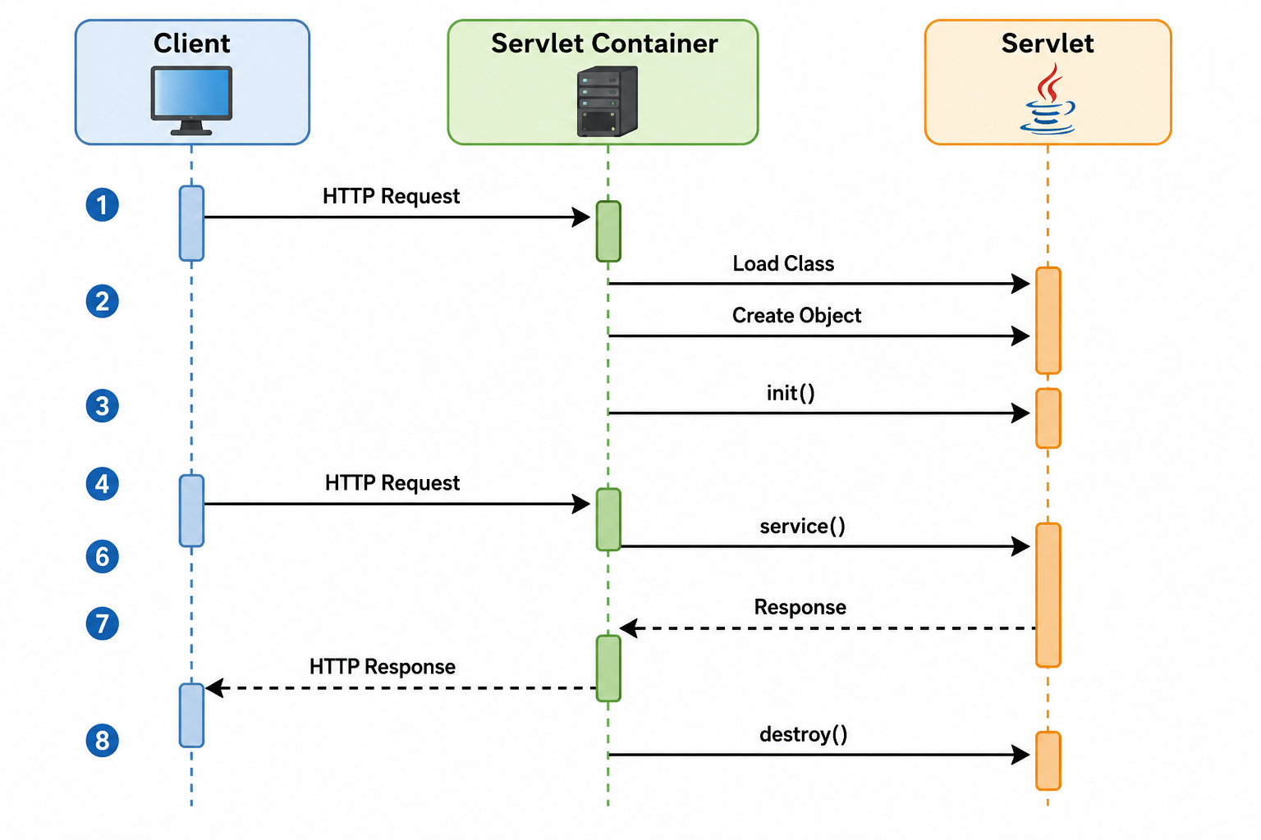
SEQUENCE DIAGRAM

Slide 10
PERFORMANCE ANALYSIS
Method | Execution | Performance Impact
init() | Once | Startup performance
service() | Every request | Response time & throughput
destroy() | Once | Resource management
Key Analysis
init() → expensive initialization affects startup.
service() → inefficient processing affects application performance.
destroy() → improper cleanup may cause resource problems.
Main Point
service() has the greatest impact on runtime performance because it executes repeatedly.

Slide 11
REAL-WORLD APPLICATIONS
Applications of Servlets
E-commerce websites
Banking applications
Student management systems
Online examination systems
Hospital management systems
Authentication systems
Enterprise web applications

Slide 12
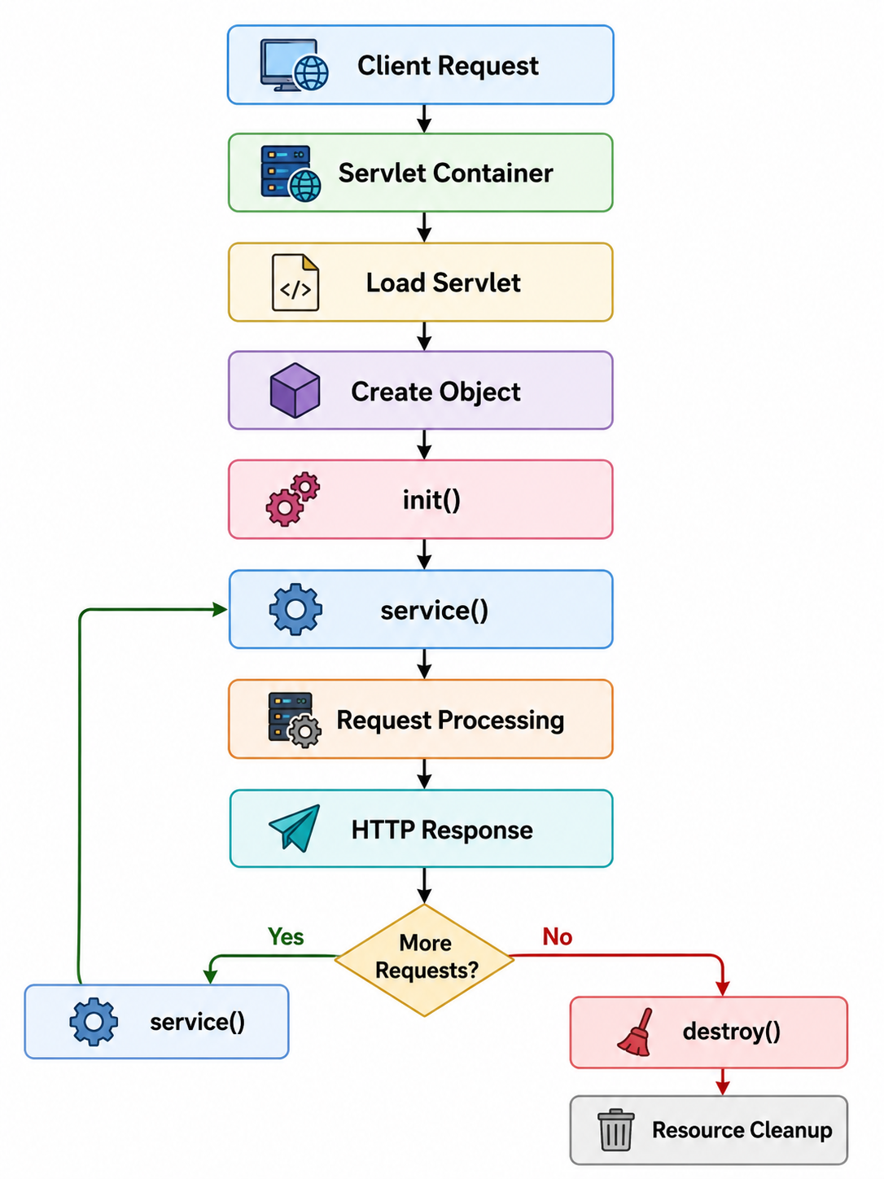
CONNECTING EVERYTHING

Slide 13
CONCLUSION
Key Takeaways
Servlet is a Java-based server-side component.
Servlet Container controls its lifecycle.
init() performs initialization.
service() processes requests.
destroy() performs cleanup.
Efficient lifecycle management improves application performance.
Understanding the lifecycle is important for developing scalable Java web applications.

Slide 14
THANK YOU

